Slide 1
Gender Inequality in STEM and LEADERSHIP
Haz Parakrama
haz@jayasun.com

Slide 2
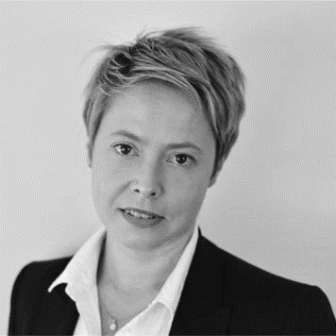
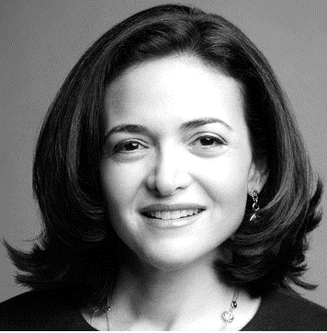
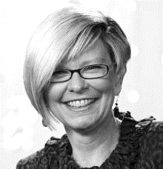
Trail Blazers
Dr. Jennifer Whelan
Psynapse Psychometrics
Founder/Director Melbourne Business School
Sheryl Sandberg
Facebook
COO
Shelley J. Correll
Professor of Sociology
Stanford University

Slide 4
WhY is this a Problem?
2012 PCAST Report
Forecasts one million more STEM graduates needed than currently expected by 2022
Increasing STEM retention by 10% would generate 75% of the needed graduates by 2022
About 25% women leave STEM for non-STEM degrees
More diverse organizations make better decisions
Less diverse organizations make worse decisions, but believe they’re good
United States becomes less competitive in STEM
Less technological advancements for humanity

Slide 5
In 2014…
Women made up 57% of the US labor force
Women were
39% of chemists and material scientists
25% of math and computer scientists
15% of chemical engineers
8% of electrical engineers

Slide 6
Why So Few?
STEM has become a boys club
Girls/Women feel unwelcome
Lack of encouragement from parents/teachers/peers
Lack of female role models
Gender stereotypes
Unconscious gender bias

Slide 7
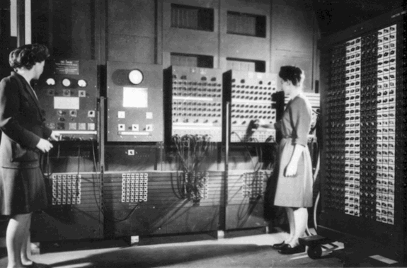
How Did We Get Here?
Historical gender roles kept women from science
WW2 required more “scientific manpower”
Shortage of men prompted training of women
1940s: ENIAC had six female computer programmers

Slide 8
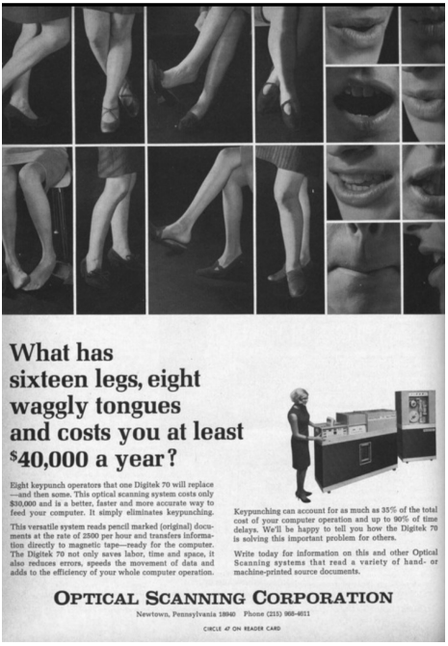
How Did We Get Here?
1960s saw explosion of female computer programmers
Computer programming was a natural career choice for women
Deemed by industry as “clerical”, easy work
Once people realized it was difficult, employers turned to training men.
Men formed professional organizations, discouraging hiring of women.
Industry ads linked female programmers to inefficiency.

Slide 9
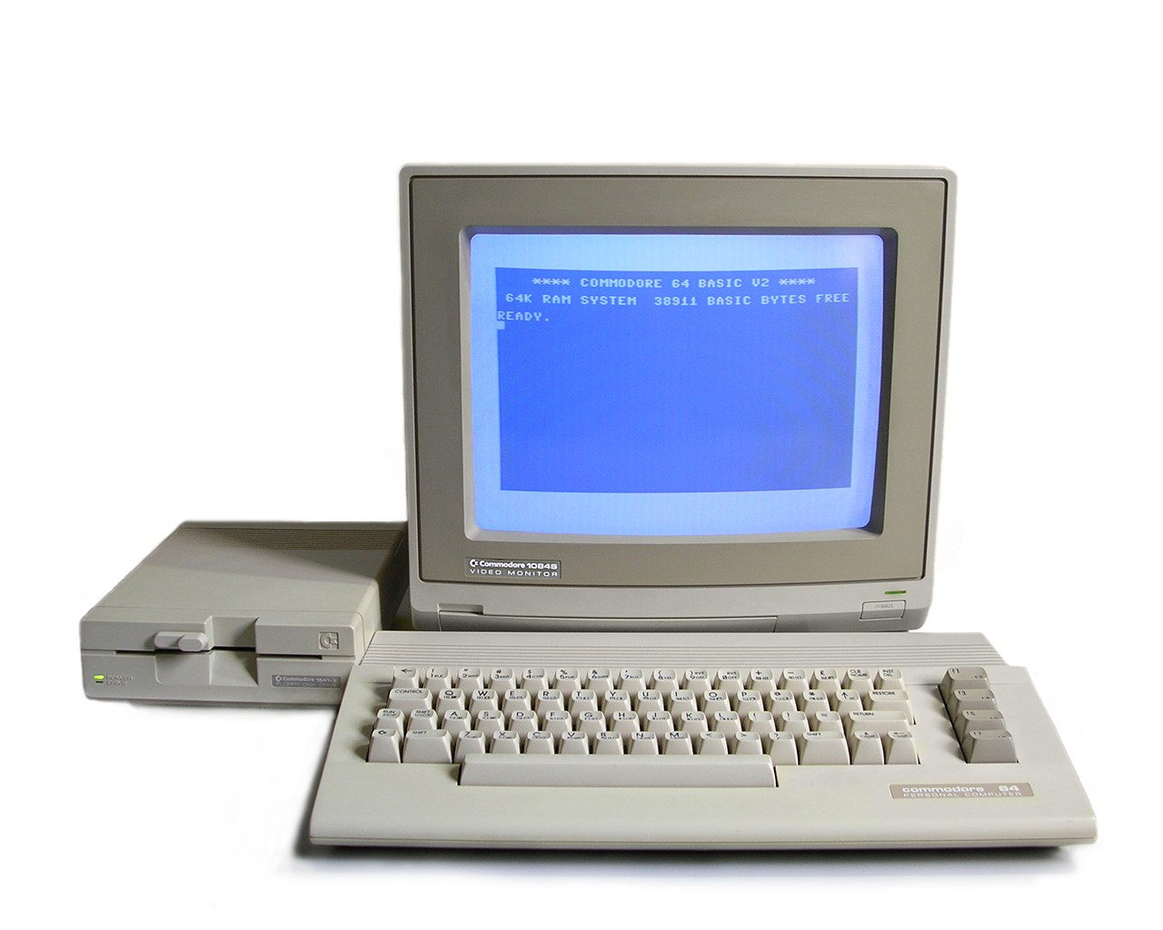
How Did We Get Here?
1980s saw the rise of the personal computer
Targeted to boys and men

Slide 11
Geek Stereotypes
Boys/Men
Antisocial
Socially ostracizing

Slide 12


GEEK STEREOTYPES
1984
2015

Slide 13
Where That Leaves Us Today
STEM is still a boy’s club
Gender imbalance leads to enforcement of gender stereotypes

Slide 14
Sexism can be subtle.

Slide 15
UNCONSCIOUS GENDER BIAS
WOMEN | MEN
Warm, caring, nurturing | Competent, dominant, powerful
Timid
Subservient
Simple
Routine
Weak
Confident
Leader
Intellectual
Strong
Curious
Explore
Discovery

Slide 16
Overcoming Gender Bias Hurdles
Youth

Slide 17
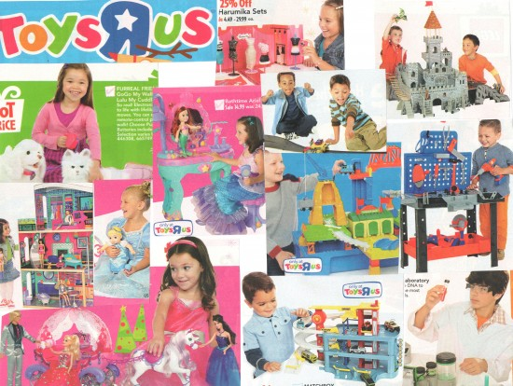
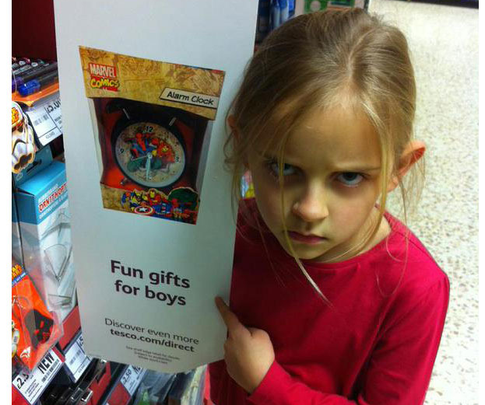
Impact at a Young Age

Slide 18
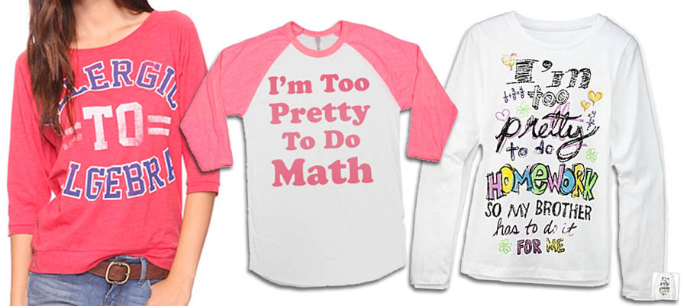
Impact at a Young Age

Slide 19
Impact at a Young Age: LACK OF Encouragement
Girls told by parents and teachers that STEM is for boys
Encouraged to participate in non-STEM activities
Adhering to gender roles

Slide 20
Overcoming Gender Bias Hurdles
Higher Education
Youth

Slide 21
Impact at a Young Age: LACK OF Encouragement
Girls told by parents and teachers that STEM is for boys
Encouraged to participate in non-STEM activities
Adhering to gender roles
By the time girls get to college, boys have a head-start in STEM

Slide 22
Overcoming Gender Bias Hurdles
Getting Hired
Higher Education
Youth

Slide 23
UNCONSCIOUS GENDER BIAS: Assistant Prof.
1999 Study: Steinpress, Anders & Ritzke
Two identical resumes
One with a man’s name
One with a woman’s name

Slide 24
UNCONSCIOUS GENDER BIAS: Lab Manager
2012 Study: PNAS – Science Faculty’s Subtle Gender Biases Favor Male Students
Two identical resumes
One with a man’s name
One with a woman’s name
Both male and female faculty members rated female candidate worse
Less competent
Less hirable
Less favorable to receive mentoring
Lower salary

Slide 25
UNCONSCIOUS GENDER BIAS: Police Chiefs
2005 Study: Uhlmann & Cohen
Two resumes
One highly educated
One highly experienced

Slide 26
Unconscious Gender Bias
Everyone does it

Slide 27
Overcoming Gender Bias Hurdles
In The Workplace
Getting Hired
Higher Education
Youth

Slide 28
Women in the Workplace
Less Influential
Women have less influence in group settings at work
Less Recognized
Women’s contributions are judged less positively
Less Rewarded
Women are less likely to get credit for their ideas
Wage gap

Slide 29
Women In The Workplace: Meritocracy
Women have to over-perform men to get the same performance rating
Organizations that pride themselves as meritocratic often show the most bias

Slide 30
Overcoming Gender Bias Hurdles
Career Advancement
In The Workplace
Getting Hired
Higher Education
Youth

Slide 31
Women in the Workplace: CAREER ADVANCEMENT
Women as leaders contradict our stereotypes
Girls called “bossy” when leading

Slide 32
Women in the Workplace: CAREER ADVANCEMENT
Lacking self-confidence
Lacking confidence in organization to support career growth

Slide 33
Women in the Workplace: CAREER ADVANCEMENT
Having a family
Men are never asked if capable of juggling family and work
Women told they “can’t have it all”
Companies unwilling to support part-time or work-from-home
Lack of family paid leave (maternity/paternity)
Extremely detrimental to poor mothers
Staying at home to care for a sick child could cost you your job

Slide 34
Women in the Workplace: Support from Men
Degradation of relationships with peers and superiors
Fear career-stifling consequences

Slide 35
What Can We Do?

Slide 36
What Women Can Do
Self-promote with positivity
Lean in
Raise awareness of gender bias
Aim high
Fake it ‘til you make it
The confidence will come
Be role models to younger girls
Join organizations
Girls Who Code
CoderDojo
She++
Lean In
If you want a partner, make sure he/she will share the housework

Slide 37

What Men Can Do
Raise awareness of gender bias
Support female peers
Mentorship, Recognition
Challenge male superiors on their criticism of female employees
“Aggressive”, “Bossy”
Offer to take notes in meetings, let women speak up
Share the housework with your partner
Join organizations
Girls Who Code
CoderDojo
She++
Lean In
HeForShe
Be aware of your own gender biases
Project Implicit: https://implicit.harvard.edu/implicit/index.jsp

Slide 38
What Organizations Can Do
Express to female employees their decision to have a family will not impact their careers
Establish support to transition them in and out of maternity leave
Support part-time opportunities, paid family leave and work-from-home
Encourage blind hiring practices
Remove names from resumes
Educate employees on gender biases
Project Implicit: https://implicit.harvard.edu/implicit/index.jsp
Join or support organizations

Slide 39

Progress
Target going gender neutral in the toy department
New Barbie advertisement
HeForShe
Rise of

Slide 40
Conclusion

Slide 41



Slide 43
Questions?
Slides available on GitHub
https://github.com/hazparakrama/
Haz Parakrama haz@jayasun.com

